Slide 1
Graduate Earnings Prediction
By: Will Tseng

Slide 2





The Motivation

Slide 3
The Data
College Scorecard Data (2011~2012)
U.S. Department of Education (made available 2015)

Slide 4
The Data
College Scorecard Data (2011~2012)
U.S. Department of Education (made available 2015)
≈ 7700 schools
≈ 1800 features

Slide 5
The Data
College Scorecard Data (2011~2012)
U.S. Department of Education (made available 2015)
≈ 7700 schools
≈ 1800 features
≈ 75% have missing values

Slide 6
The Data
College Scorecard Data (2011~2012)
U.S. Department of Education (made available 2015)
≈ 7700 schools
≈ 1800 features
≈ 75% have missing values
≈ 15% have Privacy Suppressed information

Slide 7

The Process

Slide 8
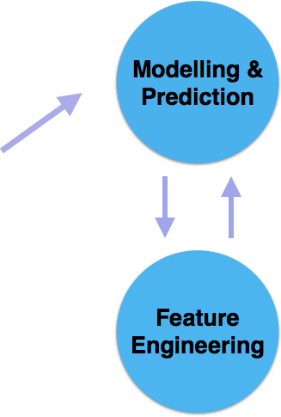
The Process

Slide 9
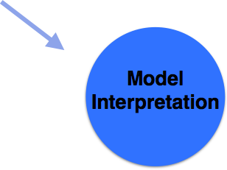
The Process

Slide 10
Prediction Results
 | Mean Squared Error | R-Squared
Lasso Regression | 0.0210 | 0.8299
Ridge Regression | 0.0201 | 0.8374
Random Forest | 0.0167 | 0.8653
Extra Tree | 0.0171 | 0.8617
Gradient Tree Boosting | 0.0160 | 0.8707

Slide 11
Prediction Results
 | Mean Squared Error | R-Squared
Lasso Regression | 0.0210 | 0.8299
Ridge Regression | 0.0201 | 0.8374
Random Forest | 0.0167 | 0.8653
Extra Tree | 0.0171 | 0.8617
Gradient Tree Boosting | 0.0160 | 0.8707

Slide 12
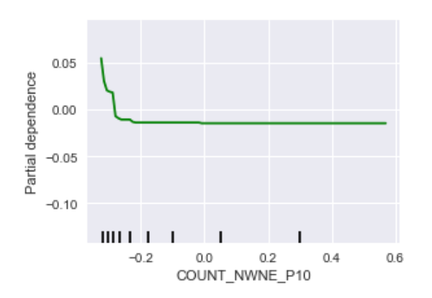
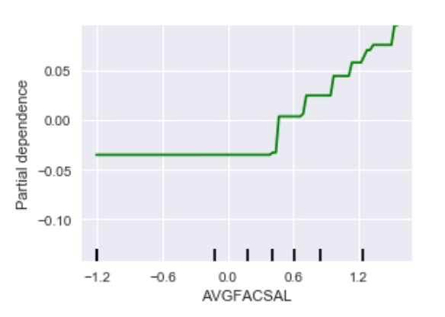
Partial Dependence
Students neither working nor studying 10 years after entry
Avg. monthly faculty salary

Slide 13
Partial Dependence
Students neither working nor studying 10 years after entry
Avg. monthly faculty salary

Slide 14
Partial Dependence
Students neither working nor studying 10 years after entry
Avg. monthly faculty salary

Slide 15
Partial Dependence

Slide 16
Partial Dependence

Slide 17
Partial Dependence

Slide 18
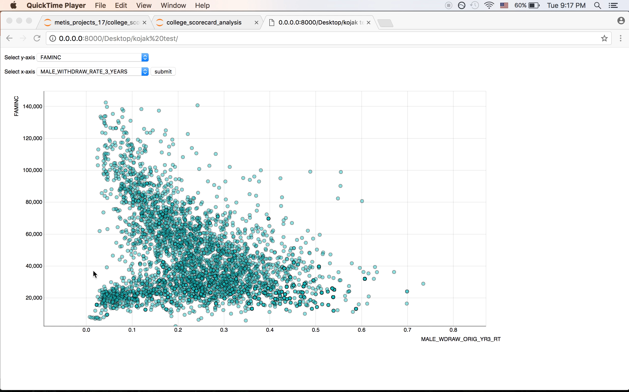

Slide 19

Thank you
William Tseng
will.tseng12@gmail.com
willtseng12

